Slide 1
Starting a Tax Return - TaxSlayer Basic Information
Form 13614-C Intake/Interview Form
Pub 4012 Tab N “Using TaxSlayer Pro Online”
NJ 1040 Pages 1 and 2
Notes:
1

Slide 2
TS – General TaxSlayer Hints
Log in to TaxSlayer by following directions provided by your district
Welcome page allows you to start a new return or do a client search for an existing return
Once in a return, you can move from one return to another by clicking on Save and Exit Return in left column or by clicking on client name at top right and then Your Office. Brings you to Welcome page
Seven main sections to TaxSlayer (left column):
Basic Information
Federal Section
Health Insurance

Slide 3
TS – General TaxSlayer Hints
(cont’d)
State Section
Summary/Print
e-File
Amended Return
When you click on a section, sub-sections may then appear in left column (sub-sections no longer at top of screen)
On the appropriate sub-section menu screen, numerous forms will be available for viewing by clicking on the Print icon next to that topic (e.g. – Sch A, B, C, D, R, 2441, 8606, 8863, 8962, 8965, etc.) New for 2017
Can view 1040 by clicking on Summary/Print. Click on any amount in blue in right column to go to source of amount
To view a form not available on sub-menu screens, go to Summary/Print, click on View/Print Return and then Print Your Tax Return. Will create a PDF of full return, including NJ forms
Notes:
3

Slide 4
TS – General TaxSlayer Hints
(cont’d)
Summary View will give you summary totals for Income, AGI, Taxes/Credits, Total Tax, Payments, Amount You Owe and NJ Refund. Click on a total to show more details
Must click on Continue to save entries on a screen (no automatic save)
Enter a form # or topic in Enter the Form Number box on upper left to find requested data entry section
If screen is inactive for 17 minutes, you will receive warning that session will expire in 3 minutes. Can choose whether to renew or not
If TaxSlayer logs out before you click on Continue, data on that screen will not be saved
Notes:
re
4

Slide 5
TS – General TaxSlayer Hints
(cont’d)
Federal and State refunds are displayed on screen
AGI is not displayed
If a required field is incorrect or missing on a screen when you click Continue, TaxSlayer will display a warning in red at top of screen
Click on warning to go to error to correct it
Enter a date without a leading zero
In Practice Lab, TaxSlayer determines whether to use Form 1040, 1040A, or 1040EZ for a particular client when you create the PDF. In Production, print set can be configured to always use 1040
Summary/Print screen always shows 1040
Notes:
re
5

Slide 6
TS – Start a New Return and Enter Taxpayer/ Spouse Information in Basic Information Section
Once screening and interviewing is done, counselors can start the tax return in TaxSlayer
Choose correct tax year (current tax year is the default)
Choose Click on Start New Tax Return
If need to do a prior year return, you can change the tax year using a drop-down menu in upper right corner
Choose one of available taxpayer profiles
Enter and confirm SS # of first taxpayer. Then click on Start Return
Basic Information Section has 3 sub-sections:
Filing Status
Personal Information (Taxpayer and Spouse)
Dependents

Slide 7
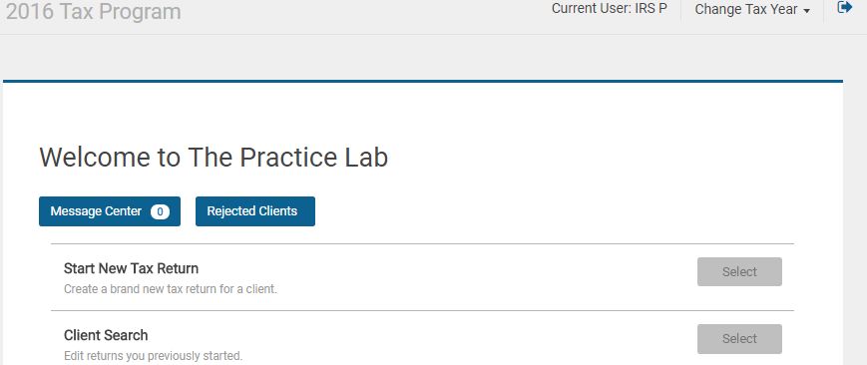
TS – Start a New Return
Start a new tax return

Slide 8
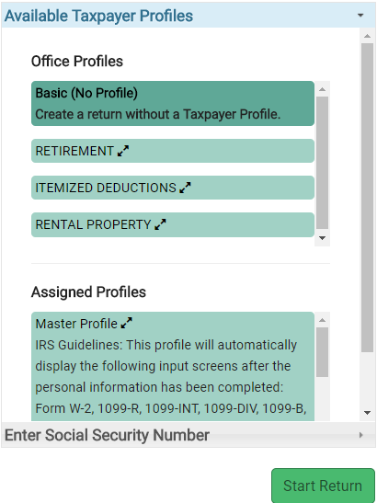
TS – Choose a Taxpayer Profile
Click on desired profile; TaxSlayer will display most common income & adjustment entry screens to match taxpayer situation

Slide 9
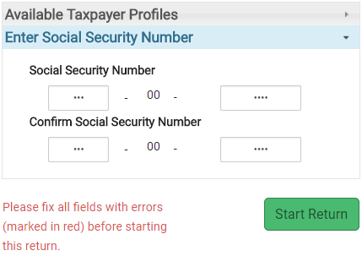
TS – Enter Taxpayer Social Security Number
Enter SS #
Confirm SS #

Slide 10
TS – Methods for Entering Information into TaxSlayer
Possible methods for entering information into TaxSlayer
Taxpayer Profiles created by site administrator
Automatically displays income and adjustment entry pages that most closely reflect information from the taxpayers visiting your site
Quickfile created by counselor for one particular tax return after entering Basic Information
Click on client’s name in upper right corner of screen
Choose Quick File from drop-down menu
Start typing form name or description of screens you will need for this particular return. Select each one to make a list. When list is complete, hit Continue
TaxSlayer will guide you to each screen in order; saves navigation steps
Notes:
10

Slide 11
TS – Methods for Entering Information into TaxSlayer
(cont’d)
Search Box
Enter form # or name in search box above left menu to go to desired input screen
Form 1040
Go to 1040 under Summary/Print section
Click on 1040 line in blue to go to entry screen for that info
Guide Me
TaxSlayer will guide you step-by-step through the return by asking questions
Enter Myself
Navigate yourself to the screens you need for a particular return
Notes:
11

Slide 12
TS – Filing Status
Choose appropriate filing status
Filing Status Wizard is available to help determine proper filing status through guided questions
TaxSlayer will tell you correct status based on your answers, but you must still click on correct filing status line

Slide 13
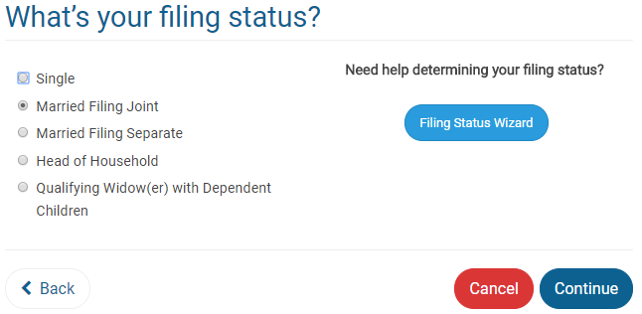
TS – Filing Status Basic Information Section \ Filing Status
Counselor clicks on appropriate
status

Slide 14
TS – Personal Information about Taxpayer & Spouse
Enter information about taxpayer and spouse in Federal section \ Personal Information
Name (Spouse’s last name pre-populated based on taxpayer’s; change if necessary)
Social Security # (Taxpayer’s # populated from # used to start return)
Date of birth
Occupation
Address
Enter zip code and TaxSlayer will automatically populate city and state

Slide 15
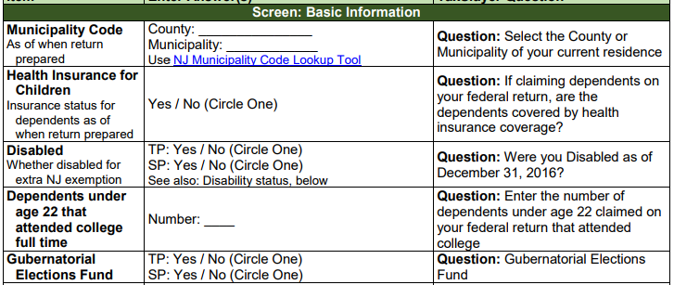
TS – Personal Information about Taxpayer and Spouse
(cont’d)
Desire to contribute to Presidential Election Fund
Note Gubernatorial Election Fund desire in the NJ Checklist Basic Information section for later entry in the TaxSlayer State section
Other situation-specific questions

Slide 16
TS – Personal Information about Taxpayer & Spouse Basic Information section \ Personal Information
Name
Date of birth
SS # from start of return
Check boxes that apply
Presidential Election Fund

Slide 17
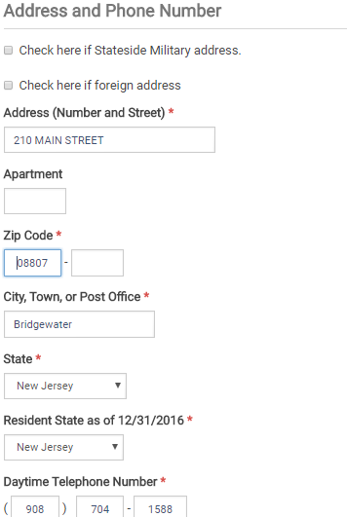
TS – Personal Exemption for Taxpayer & Spouse Basic Information Section \ Personal Information
(cont’d)
Address
Enter zip code; TaxSlayer populates city & state
Resident state as of 12/31; *
Determines which state return to file
* If no state return to complete, choose None as Resident State

Slide 18
TS – TaxSlayer Automatically Starts NJ Return
Based on Resident State as of 12/31 entry, TaxSlayer automatically starts the appropriate state return
Makes NJ refund monitor available as soon as first income entry is made
To start the NJ return, must answer 4 basic questions:
County/Municipality code
Health insurance for dependents
Gubernatorial Elections Fund
Taxpayer/Spouse PINs (created by counselor)
Notes:
TaxSlayer starts the state return as soon as Personal Information is entered. This allows you to see the NJ refund monitor as soon as you start entering income
TaxSlayer entries can almost always be made in any order. However, we recommend that you complete sections in the order of the Main Menu
As you enter data in the Federal section, note any information that may have to be changed on the NJ return due to different tax law. Capture that information on the NJ Checklist so that you don’t forget to enter it when you get to the State section
Also helpful in Quality Review process
Instructions for special fields and adjustments are given in the slides covering both federal and NJ entry for each topic

Slide 19
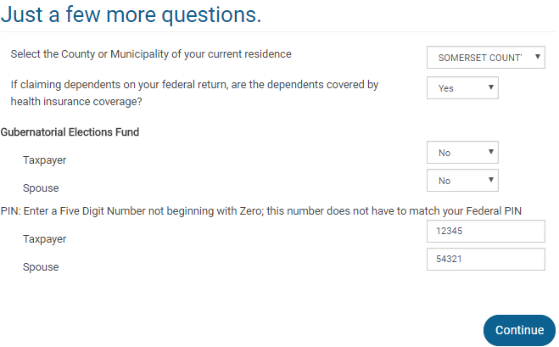
TS – Basic Questions to Start NJ Return
Municipality code
Dependents health insurance
Gubernatorial Election Fund
NJ PIN; does not have to match Federal PIN

Slide 20
TS – Dependent Information
To enter information about a dependent and/or qualifying person:
Name (Last name pre-populated based on taxpayer’s; change if necessary)
Date of Birth
Social Security #
Relationship
Number of months living in home
If dependent was born/adopted/died or was temporarily absent in tax year, # of months is 12
Can choose reason if dependent did not live in home (lived in Canada or Mexico, divorced/separated, kidnapped, etc.)
Other situation-specific questions

Slide 21
TS – Dependent Information Basic Information \ Dependents\Qualifying Person
Name
Date of birth
SS #
Relationship
# of months in home; 12 if born, adopted or died during year
Check boxes that apply

